Slide 1
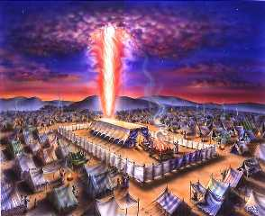
THE TABERNACLE

Slide 2
Exodus 25:8
And let them make me a sanctuary; that I may dwell among them.

Slide 3
Exodus 25:9
According to all that I shew thee, after the pattern of the tabernacle, and the pattern of all the instruments thereof, even so shall ye make it.

Slide 4
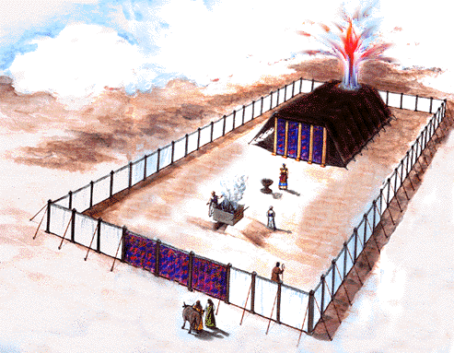

Slide 5
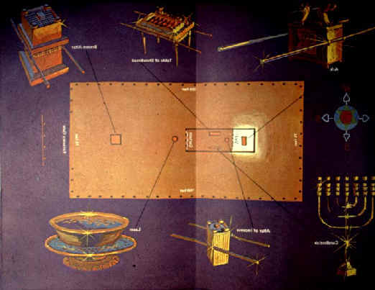

Slide 6
THE TABERNACLE
A TYPE OF CHRIST AND HIS MINISTRY
JESUS CHRIST – OUR HIGH PRIEST
OUR SAVIOR

Slide 7
THE OUTER COURT
THE GATE
THE ENTRANCE ON THE EAST SIDE
THE BRAZEN ALTAR
THE LAVER

Slide 8
THE HOLY PLACE
THE TABLE OF SHEWBREAD
THE GOLDEN CANDLESTICK
THE ALTAR OF INCENSE

Slide 9
THE HOLY OF HOLIES
BEHIND THE VEIL
THE ARK OF THE COVENANT
THE PRESENCE OF GOD
THE GLORY OF THE LORD
THE MERCY SEAT

Slide 10
THE ARK OF THE COVENANT
A POT OF MANNA
THE TABLES OF THE TEN COMMANDMENTS
AARON’S ROD THE BUDDED

Slide 11
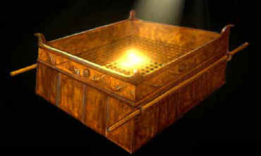
THE BRAZEN ALTAR

Slide 12
THE BRAZEN ALTAR
BRASS – TYPE OF JUDGEMENT
THIS IS WHERE SIN IS DEALT WITH
A TYPE OF THE ATONEMENT OF JESUS CHRIST
THE CROSS

Slide 13
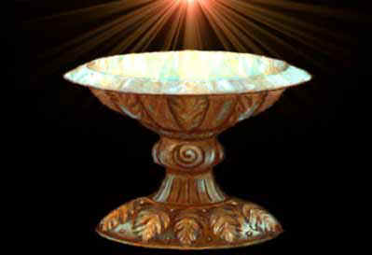
THE LAVER

Slide 14
THE LAVER
THIS IS A TYPE OF CLEANSING
SANCTIFICATION
Ephes. 5:26
That HE might Sanctify and Cleanse it with the washing of water by the word,
SALVATION

Slide 15
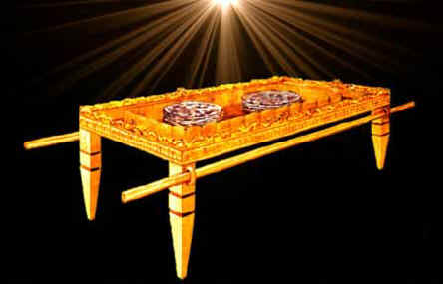
TABLE OF SHEWBREAD

Slide 16
TABLE OF SHEWBREAD
A TYPE OF THE WORD
DAILY PROVISION
DAILY FOOD FOR THE SOUL
FOR THE PRIESTS TO EAT
SHITTIM WOOD OVERLAID WITH GOLD

Slide 17
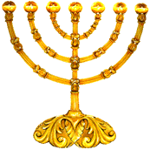
THE GOLDEN CANDLESTICK

Slide 18
GOLDEN CANDLESTICK
A TYPE OF THE LIGHT
JESUS IS THE LIGHT OF THE WORLD
WE ARE HIS LIGHT ON EARTH
PURE GOLD – A BEATEN WORK
A TYPE OF THE SACRIFICE OF CHRIST

Slide 19
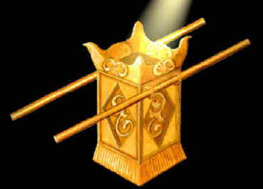
ALSO CALLED THE GOLDEN ALTAR

Slide 20
ALTAR OF INCENSE
A TYPE OF PRAISE AND PRAYER
SHITTIM WOOD OVERLAID WITH GOLD
THIS WAS PLACED BEFORE THE VEIL
THE INCENSE WAS NEVER TO GO OUT

Slide 21
BEFORE THE VEIL
THE ALTAR OF INCESENCE
DAILY, CONTINUAL BEFORE THE LORD
THIS IS OUR ACCESS TO THE HOLY OF HOLIES

Slide 22
BEHIND THE VEIL
THE VEIL WAS BEFORE THE HOLY OF HOLIES
A SEPARATION POINT
GOD’S PRESENCE WAS BEHIND THE VEIL
THE HIGH PRIEST WENT ONCE A YEAR BEHIND THE VEIL

Slide 23
Matthew 27:51
And, behold, the veil of the temple was rent in twain from the top to the bottom; and the earth did quake, and the rocks rent;

Slide 24
Hebrews 10:20
By a new and living way, which he hath consecrated for us, through the veil, that is to say, his flesh;

Slide 25
Hebrews 6:19
Which hope we have as an anchor of the soul, both sure and stedfast, and which entereth into that within the veil;

Slide 26
ACCESS TO THE LORD
THE VEIL WAS RENT AT CHRIST’S DEATH
JESUS HAS PROVIDED US ACCESS TO THE THRONE
JEUSUS IS OUR HIGH PRIEST
WE CAN ENTER HIS PRECENSE FREELY

